Slide 1

A Smart camera for the iot
Giuseppe Bisicchia
Jacopo Bandoni

Slide 2
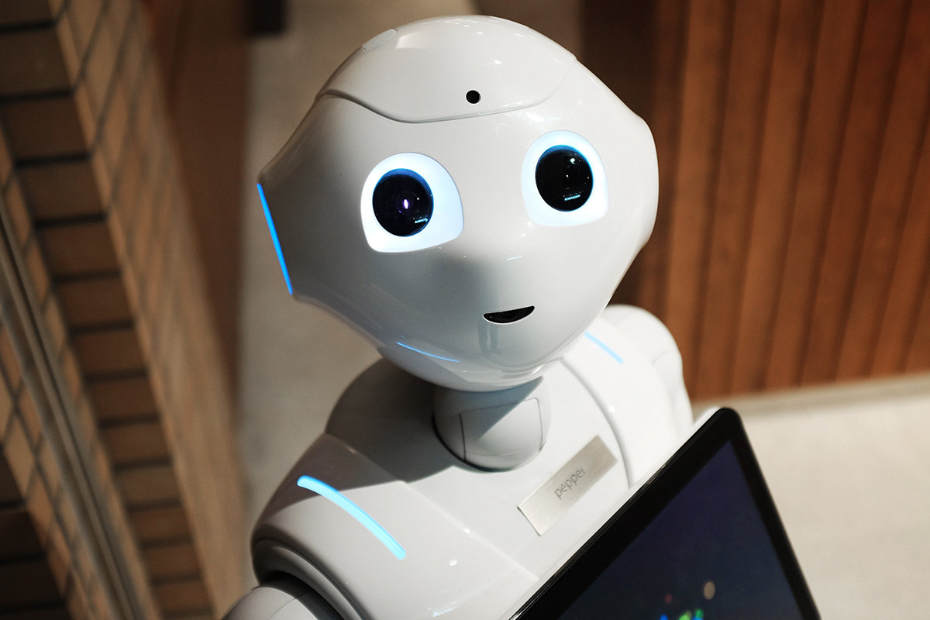
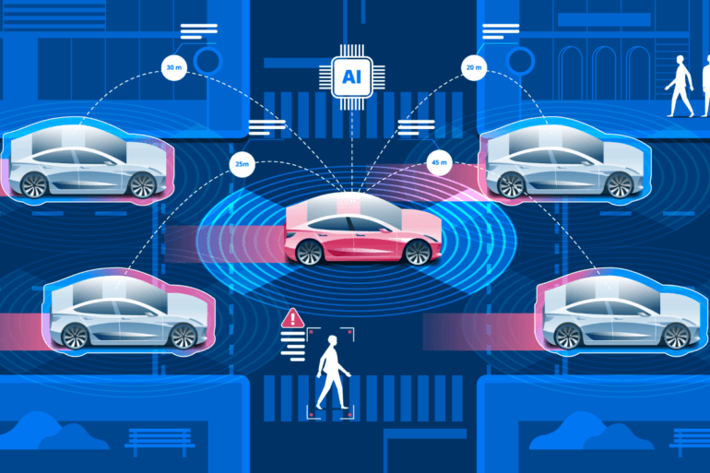
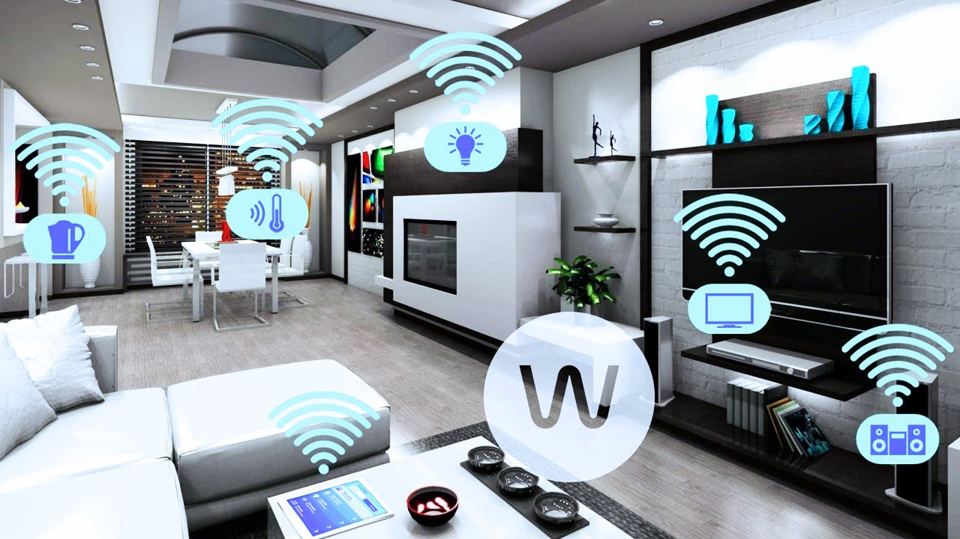
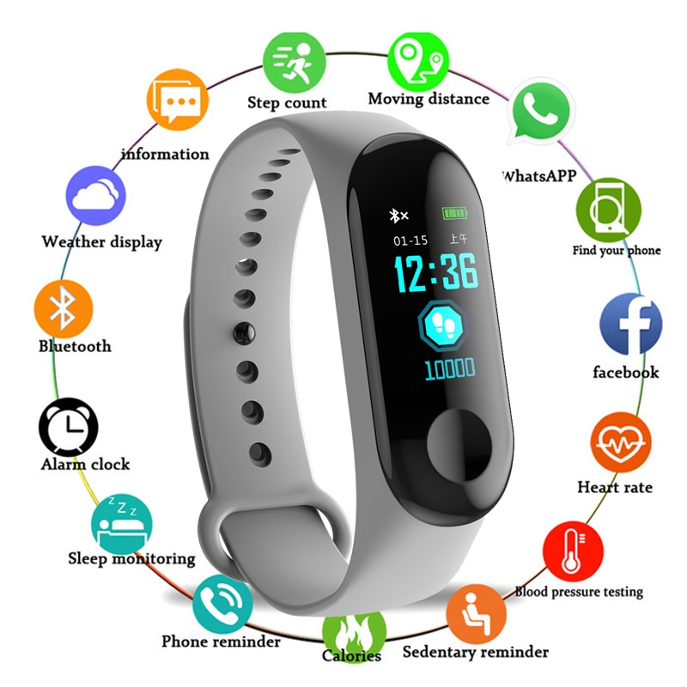
Pervasive iot
Robotics
Domotics
Autonomous Vehicle
Smart Wearable

Slide 3
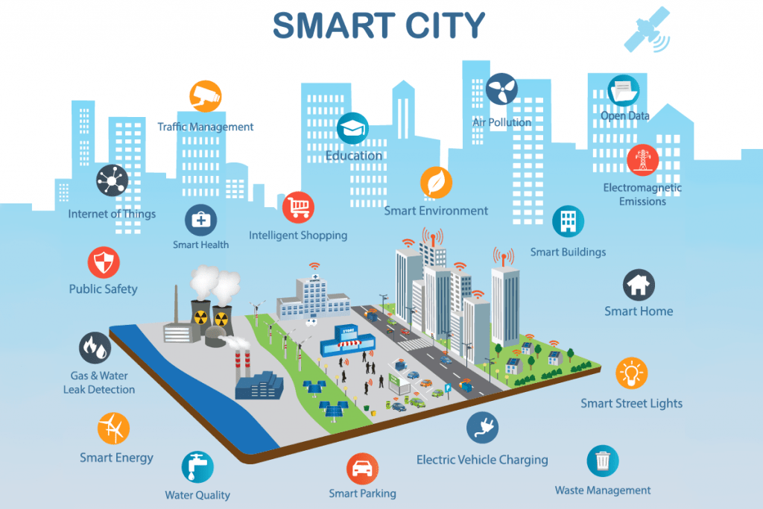

smart cities

Slide 4
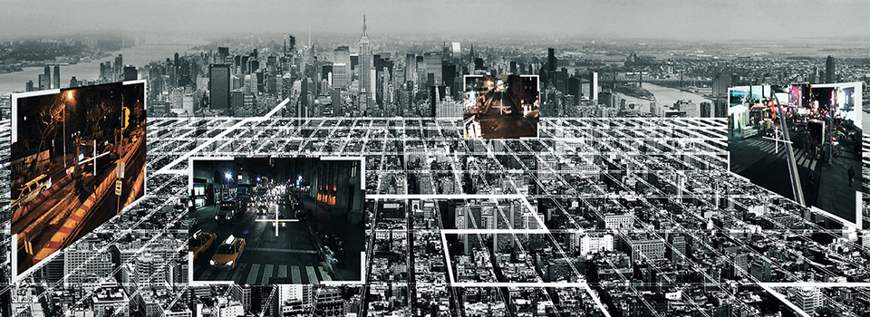

smart cameras

Slide 5
Cloud approach
Single point of failure
high computational and storage power
Risk of overloading

Slide 6
local approach
NO Internet connection
Limited computational and storage power
Risk of data loss

Slide 7
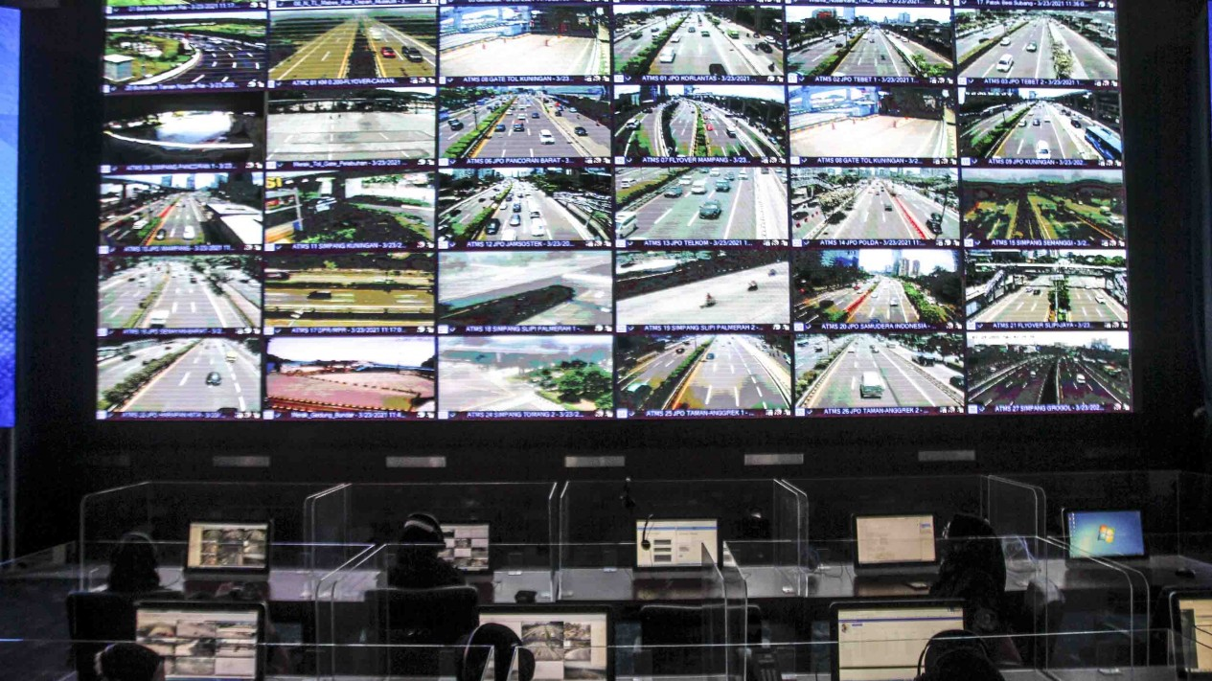
Use case: smart city
In a smart city there can be numerous heterogeneous IoT cameras.
It is not possible to guarantee that cameras are always connected to the Internet.
It is important that the management of the network is as efficient as possible given the amount of data.
It is necessary to have a global view of the whole city.
It may also be necessary to focus on a specific area to make detailed observations.
In some cases the cameras can be placed in areas where nothing happens most of the time.

Slide 8
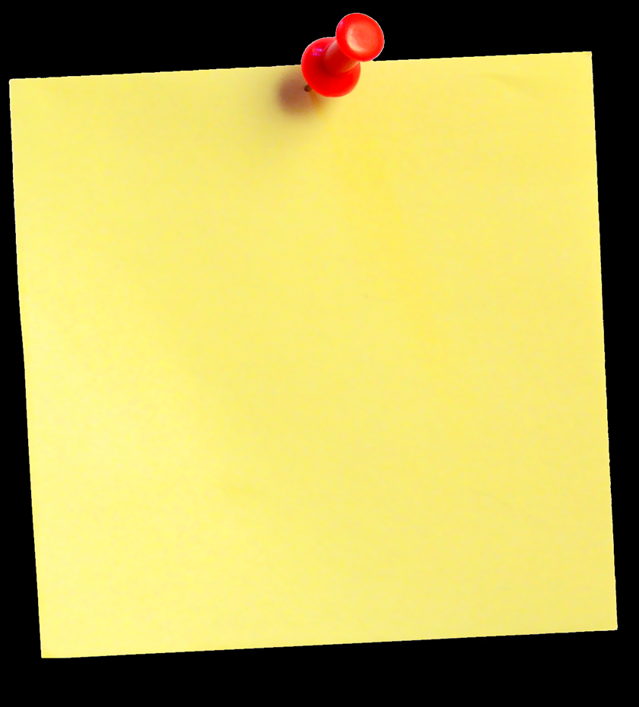
The problem
Is it possible to design a system of several cameras that is efficient from network point of view and that is able to work both alone and integrated with a centralised cloud?

Slide 9
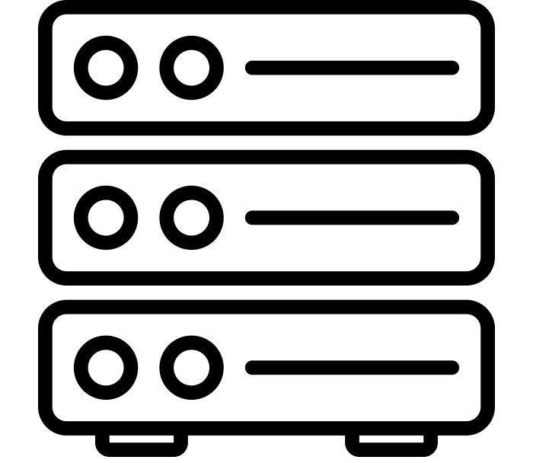
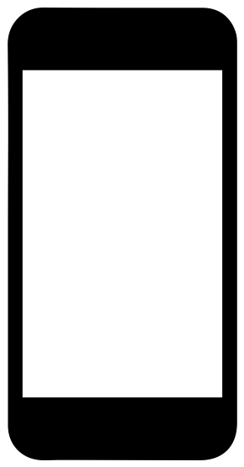


a hybrid approach
Frames
Server
Frames & Metadata
Frames & Live Streaming
SmartCam
UI
User

Slide 10
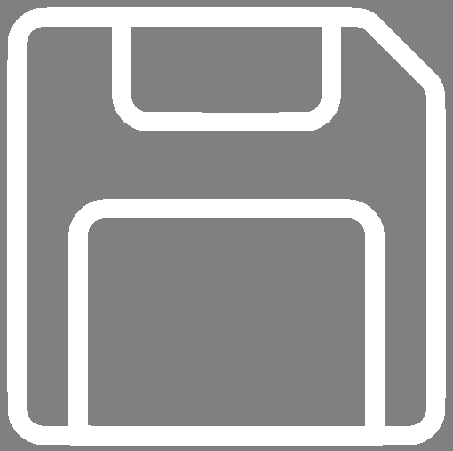

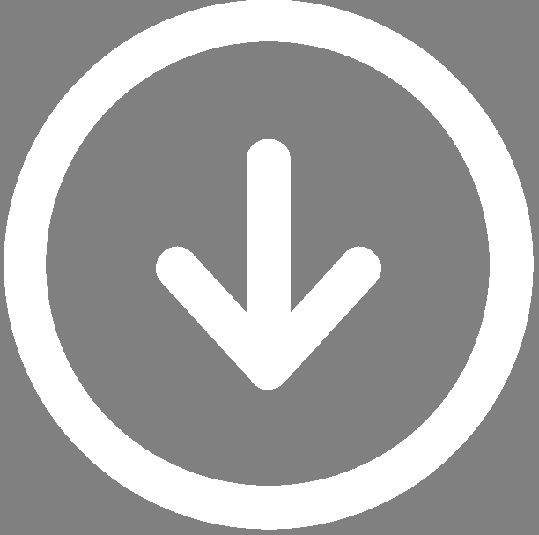



server
Stores frames and metadata
Send a frame upon request
Send a stream of the stored frames

Slide 11
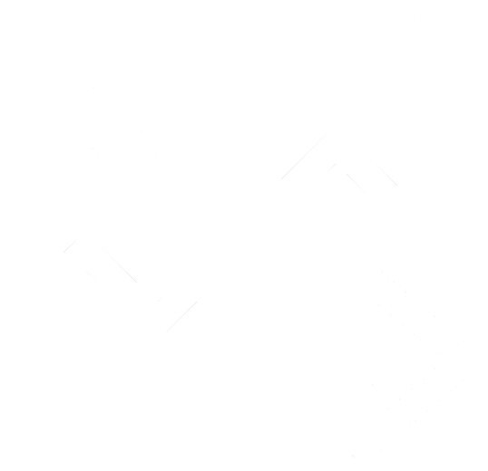
Smartcam
Stores periodically frames and metadata
Can optimise the management of stored and sent frames
Can send a frame upon request
Sends a frame periodically to the server
Sends a stream of the stored frames
Live streaming on demand
Notes:
Dynamic configuration

Slide 12
smartcam
Viewer
(Interacts with the user)
Requests frames
Sends the new configuration
Requests the current configuration
Worker
(Stores and sends frames)
Controller
(Manages the configuration)
Updates the configuration

Slide 13



User interface
Retrieves higher quality data from the camera when needed
Retrieves a preview of frames from the server
Establishes the connection with the camera and the server

Slide 14
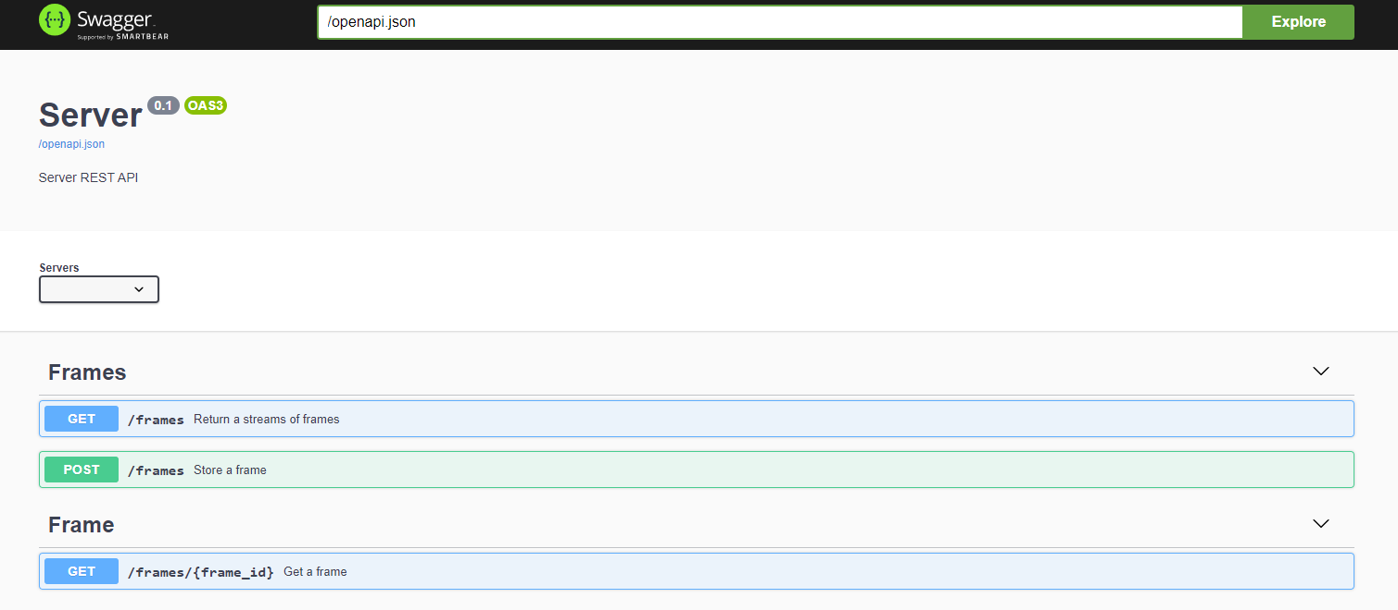



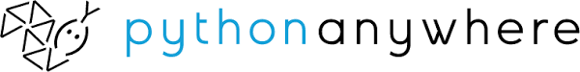
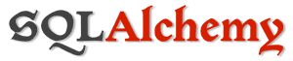
IMplementation: the server

Slide 15
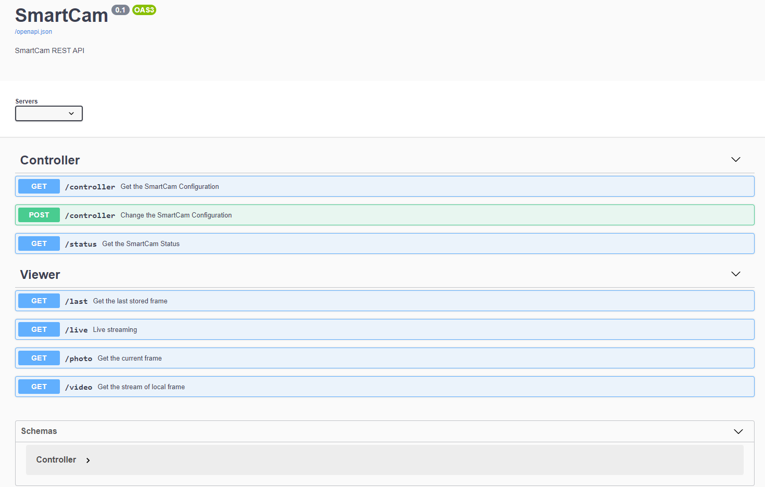



IMplementation: the smartcam

Slide 16
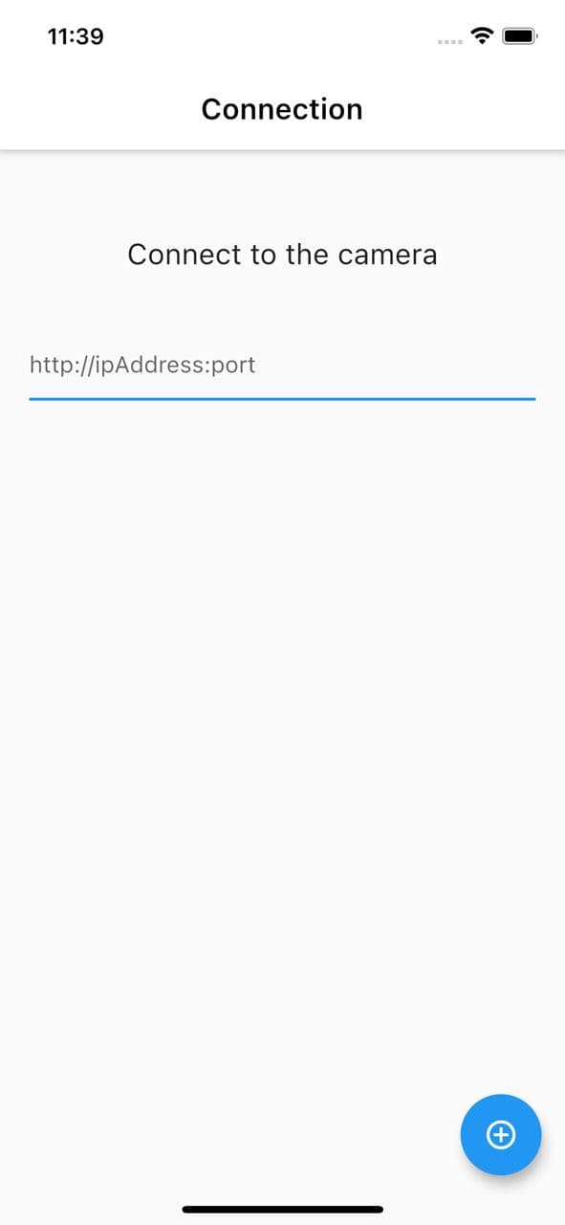
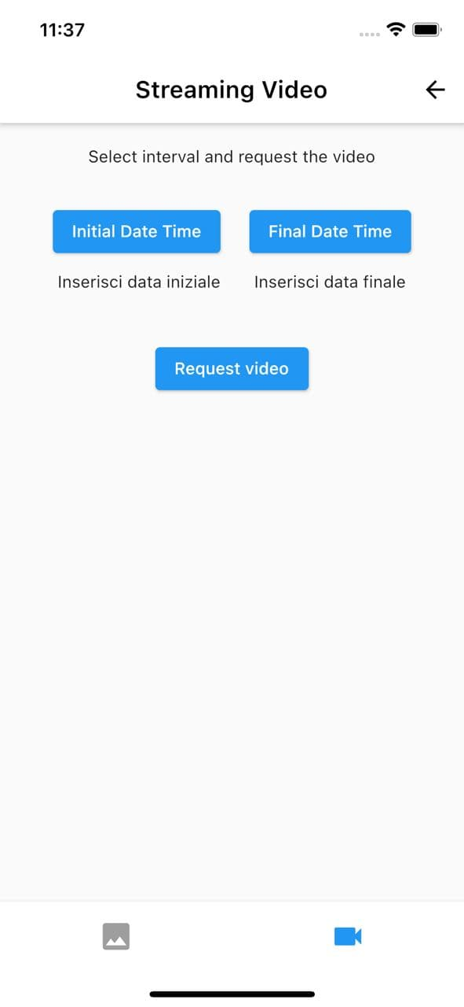
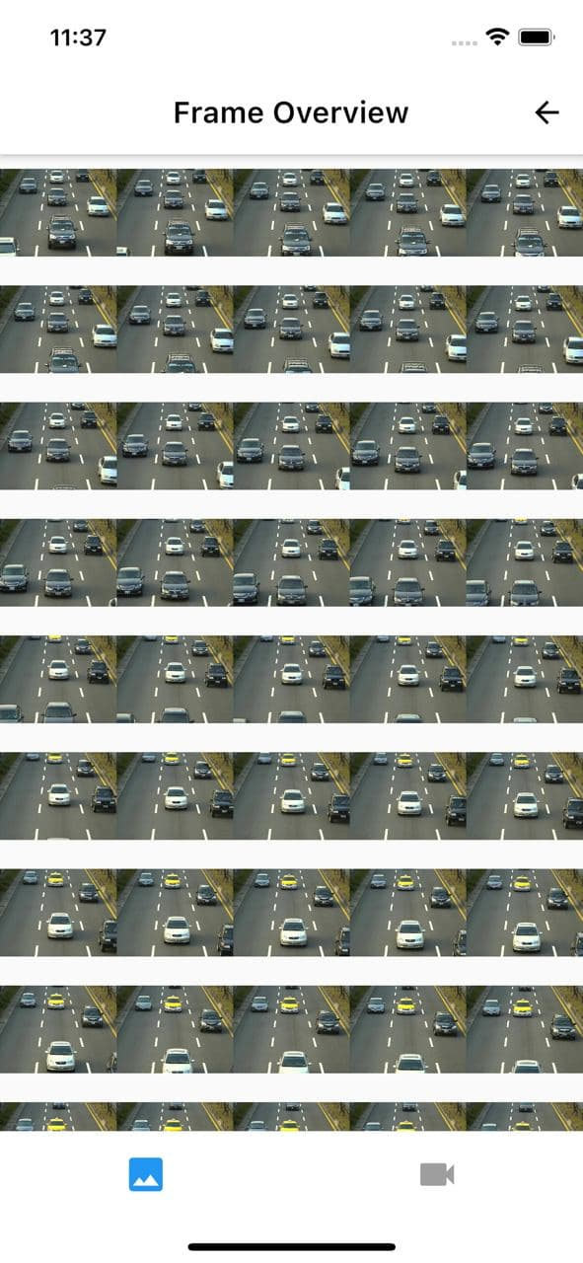
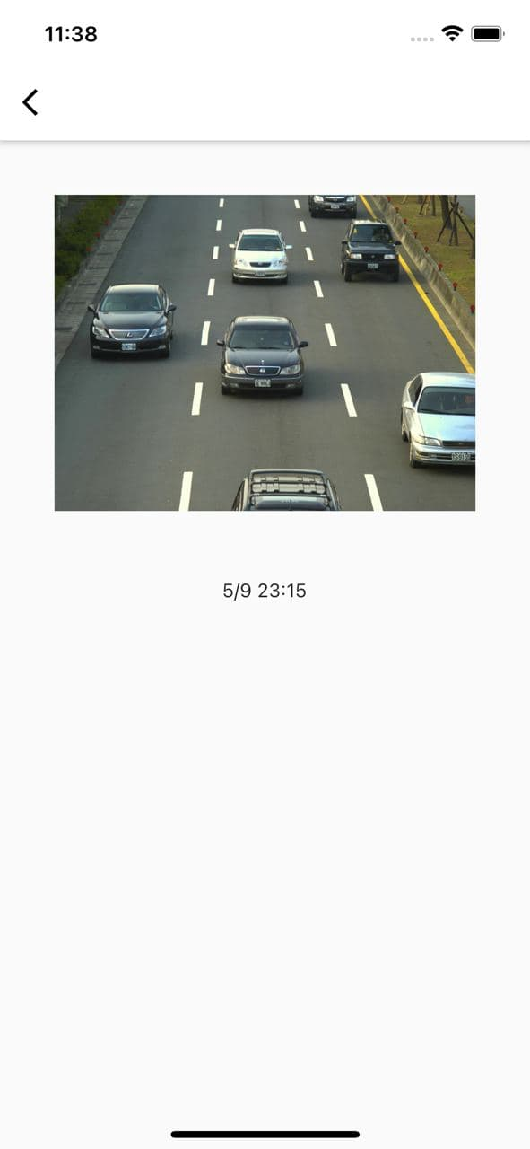

IMplementation: the user interface

Slide 17
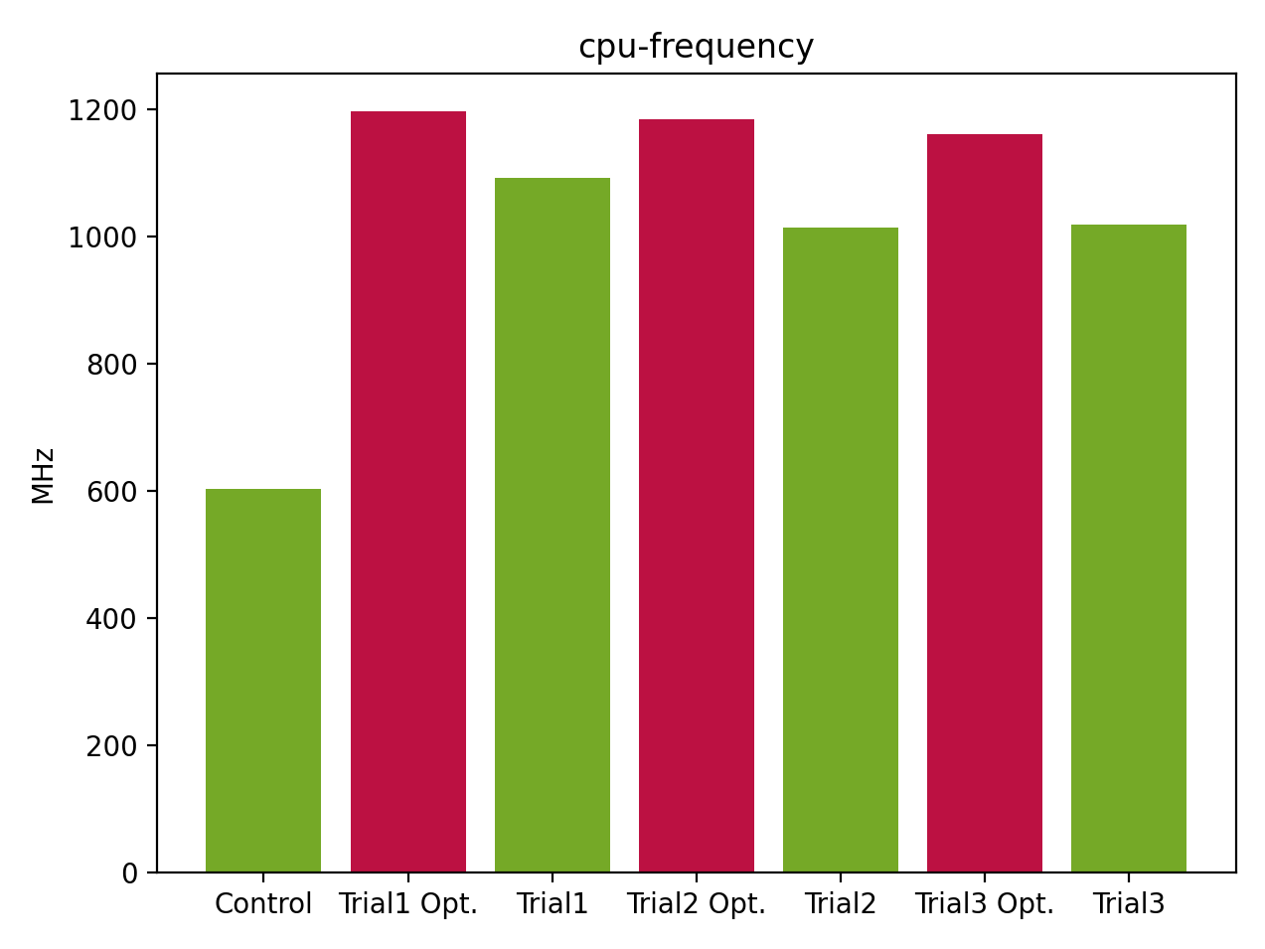
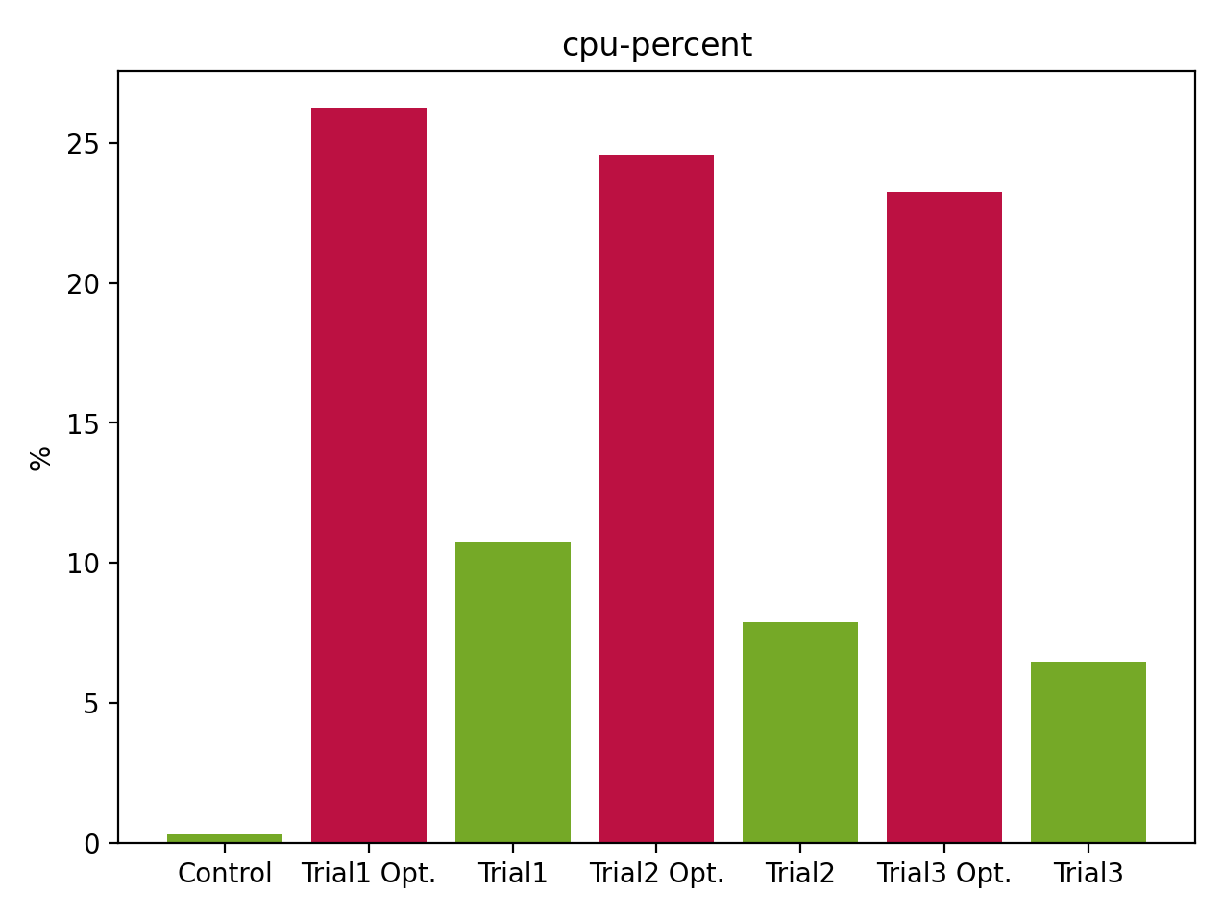
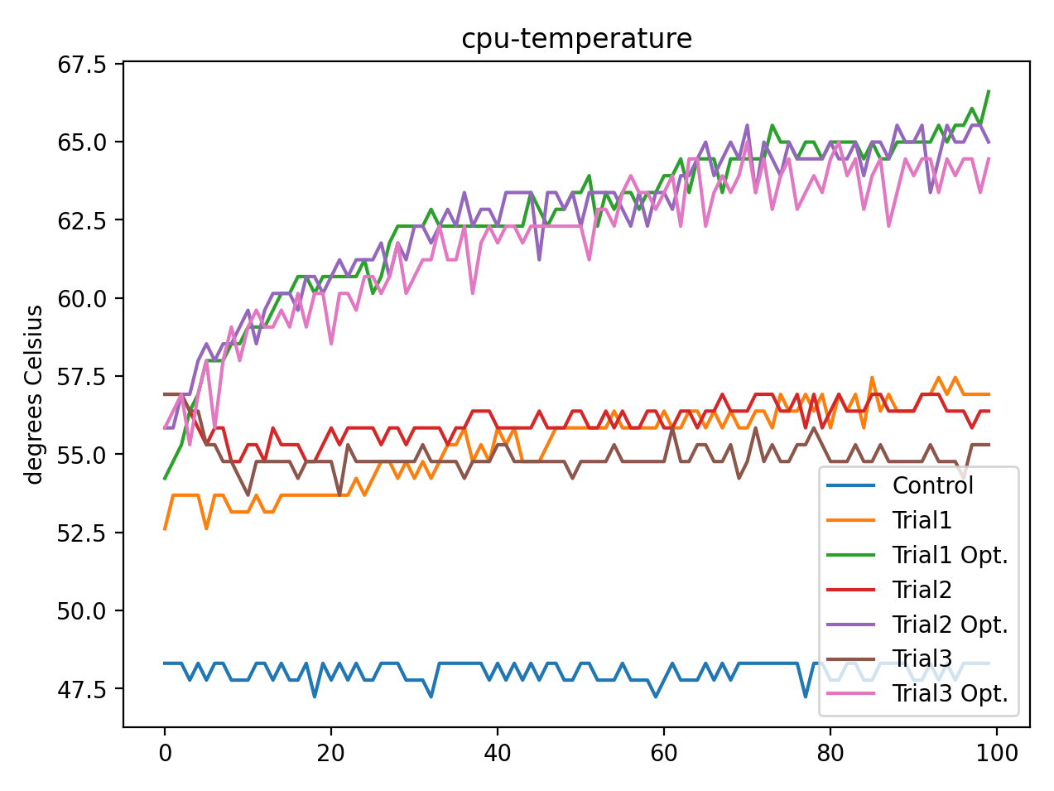
experiments: cpu

Slide 18
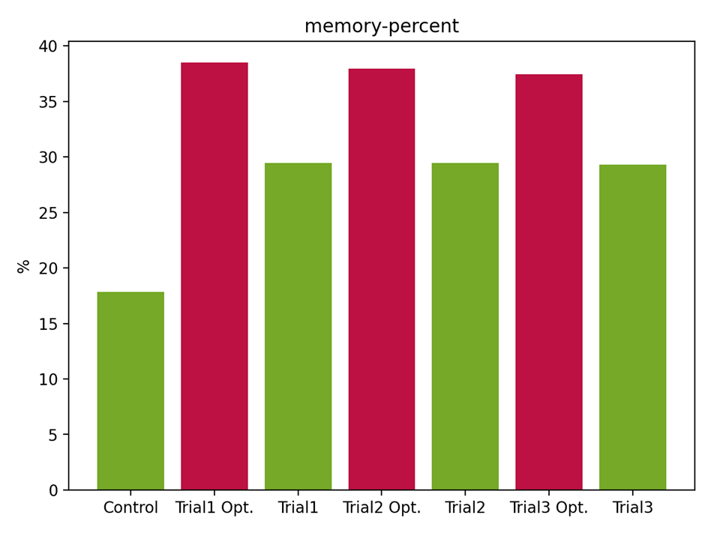
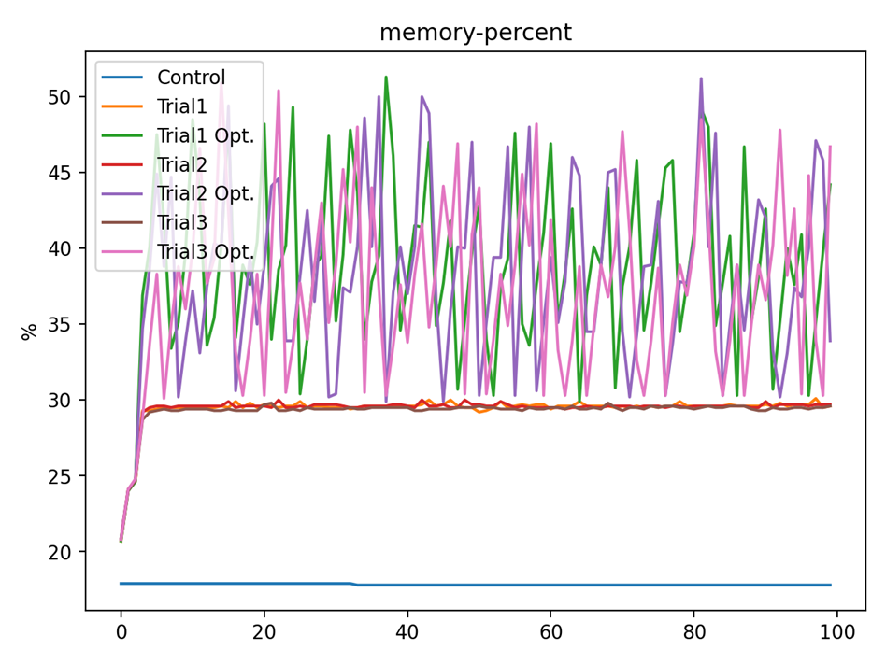
experiments: Memory

Slide 19
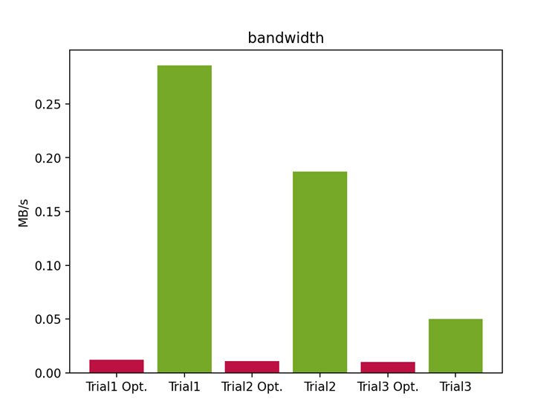
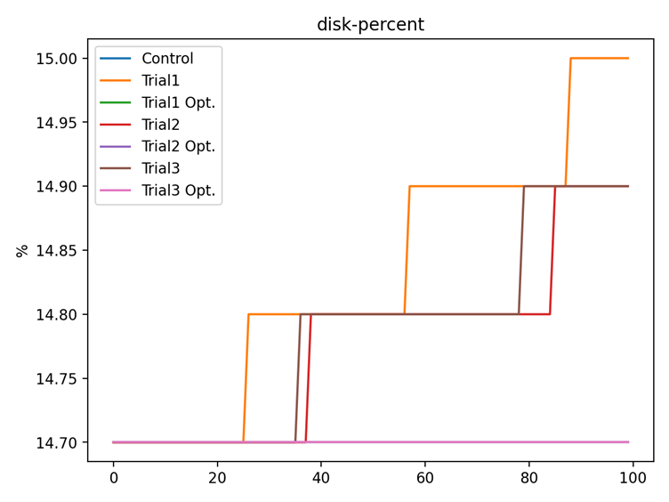
experiments: disk & Bandwidth

Slide 20
Conclusions
Hybrid approach that seeks to mitigate the cons of totally cloud or local solutions
SmartCam configurable on demand with possible options for tradeoff between the use of the CPU and quantity of stored and sent frames
User Interface that allows to interact both with the cloud and the cameras

Slide 21

thanks for your attention!

